Slide 1

WIA3002
Final Year Project I
Blockchain Based VR Multiplayer Shooter Game
Supervised by:
Senior Lecturer. DR. ALI MOHAMMED MANSOOR ALSAHAG
Presented by:
AbdlRahman Essa (WIF160711)
& Bisher Dokkmak (WIF160707)

Slide 2
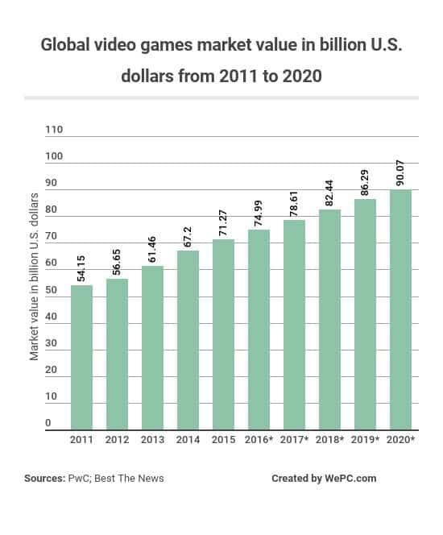
Introduction
The gaming industry is an ever growing and evolving industry. With value expected to reach 90 billion US dollars by the year 2020.

Slide 3
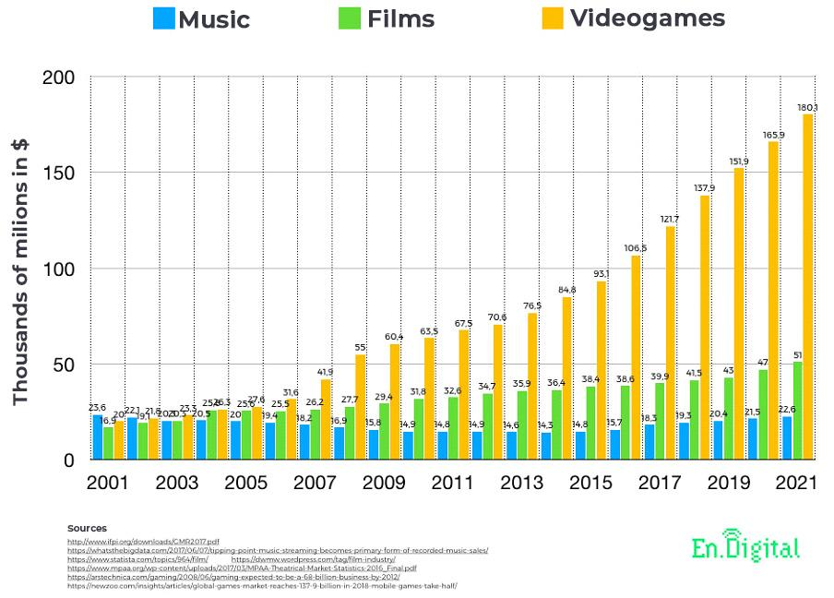
Introduction
Meaning Gaming Industry is worth more than the Film and Music Industry combined throughout the years since 2015.

Slide 4
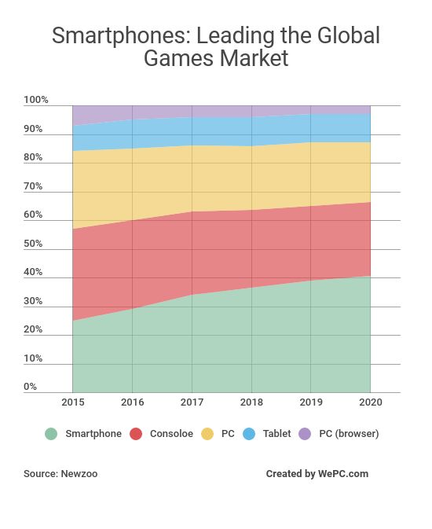
Introduction
Smartphone and tablets games taking up to 34% from the entire global gaming market in 2015.

Slide 5
Existing Games Don’t support:
1- Creation of unique non-fungible personalized assets.
2- Reuse of gaming assets like weapons, skins, etc. outside of the game.
Existing Blockchain games lack compelling gameplay.
Absence of the following features in VR games domain:
1- ‘Market hit’ Scheme
2- Affordable equipment
3- Complicated setup for trackers
4- in-platform compatibility for VR SDKs and Hardware
Problem Statement

Slide 6
Contributions
Abdulrahman

Slide 7
Joint Development Core Game Mechanics (Unreal Engine)
Blockchain Research and modules Development.
Networking Research and modules Development.
Blockchain deployment.
Technologies used: JavaScript, NodeJs & C++ for Development.
Solidity to create Ethereum smart contracts.
Abdulrahman:

Slide 8
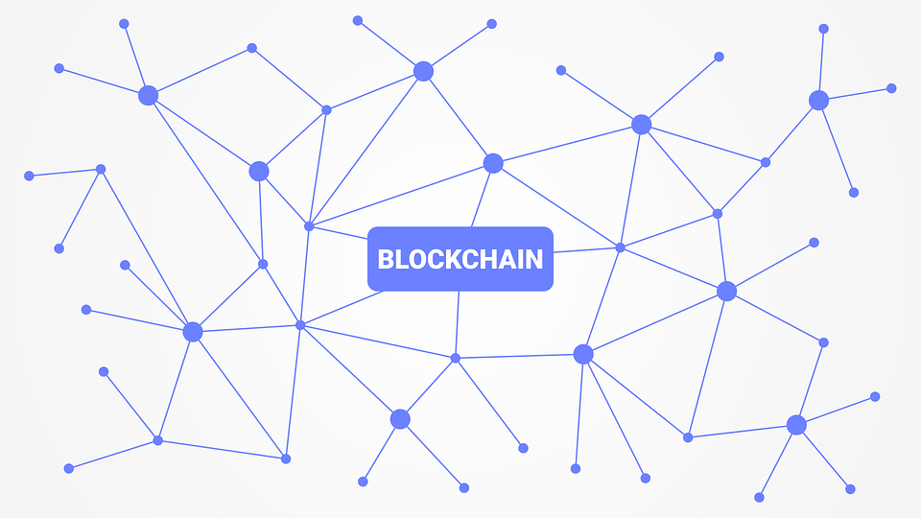
Background

Slide 9
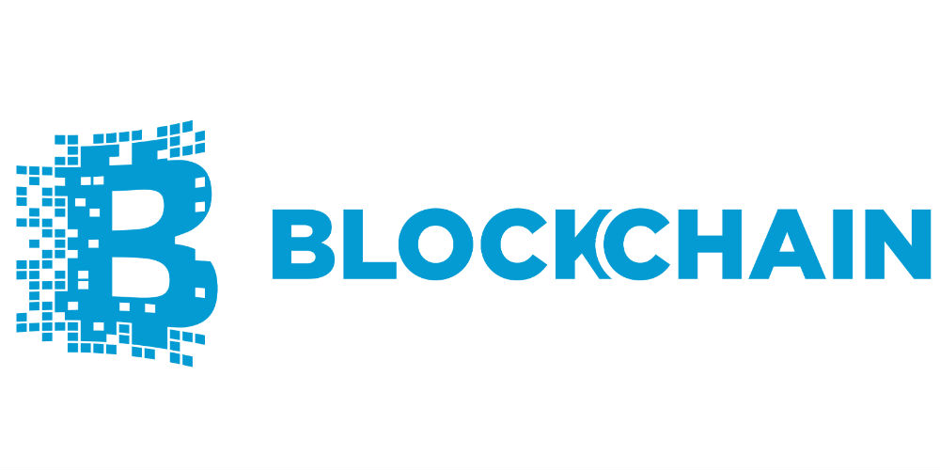

Quick intro: What are Blockchains?
Blockchain isn’t Bitcoin and isn’t crypto currency.
It is Essentially a chain of blocks
Each block contains data of value without any central supervision.
It is cryptographically secure and immutable.

Slide 10
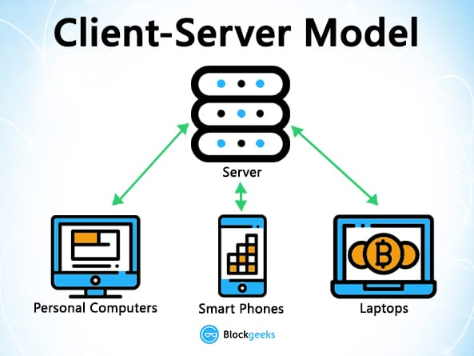
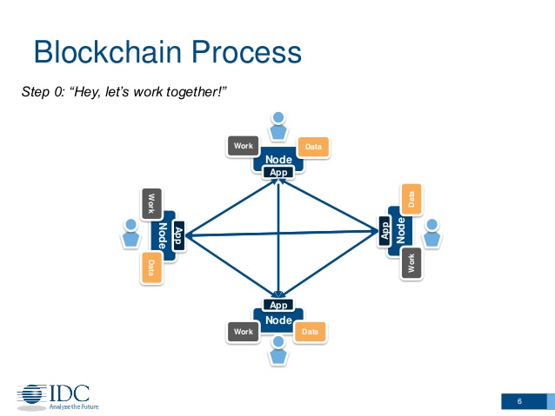
What Blockchains allow us to do?
Assets are owned by Identities.
Identities are public keys.
Transactions are signed by a digital signature which connects it to an identity.
Each block contains the cryptographic hash of the previous block.
Integrity is protected by secure hashes.

Slide 11
Our Scope: Blockchain games
Are they even possible?

Slide 12
How are blockchain games different from traditional games?
Traditional Games
Assets are owned and controlled by the game developer
Game assets are not transferable between games
Player history is hard to track and share between games
Blockchain Games
Assets are owned and controlled by the player
Blockchain game assets are interoperable across games
A continuous record of player and data history allows developers to create personalized content

Slide 13
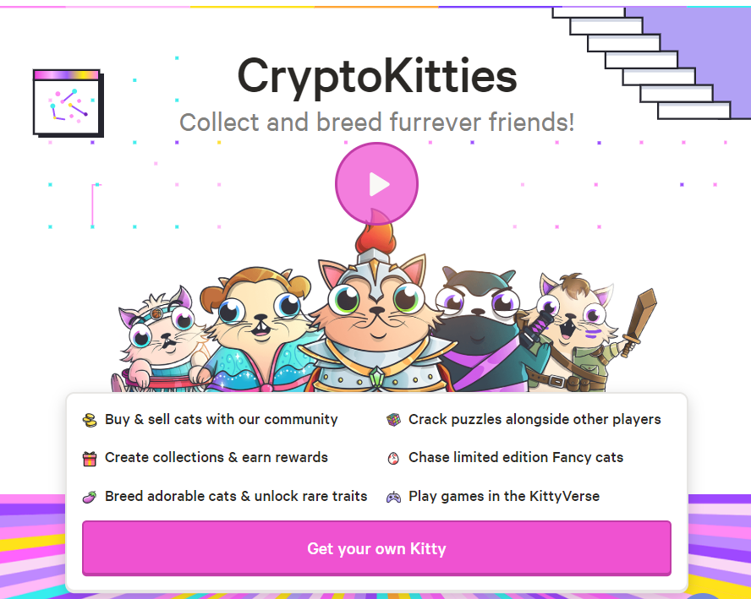
Literature review : Crypto Kitties
Buy and sell cats in exchange for cryptocurrency.
Pay to use existing functions to breed new cats with new traits.

Slide 14
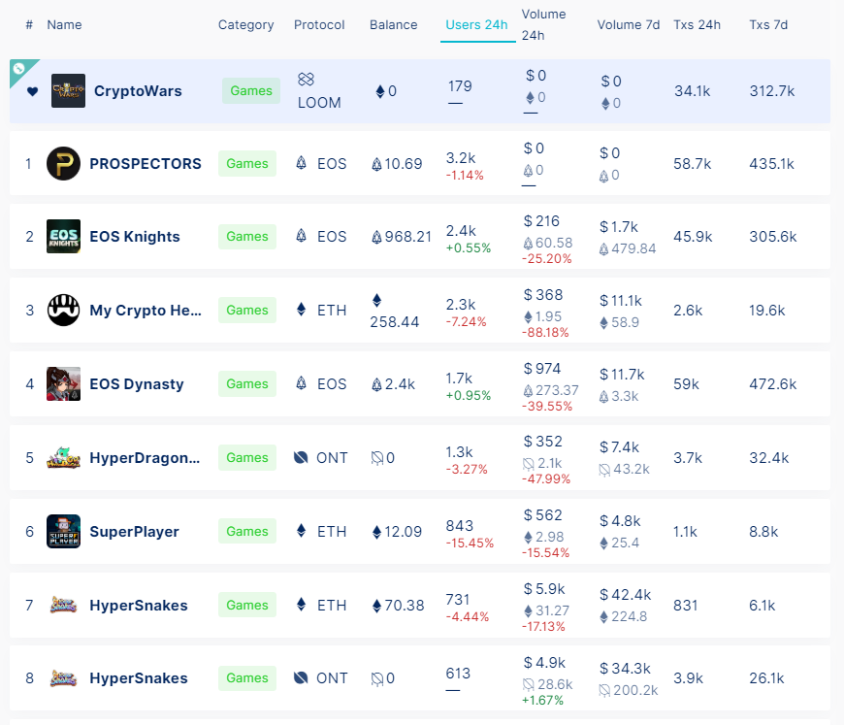
List of Blockchain games on DappRadar
The most famous games on DappRadar lack the appeal for a mass gamers.
For example, if I go to top apps on DappRadar or State of Dapps, I cannot find a single game with compelling gameplay.

Slide 15
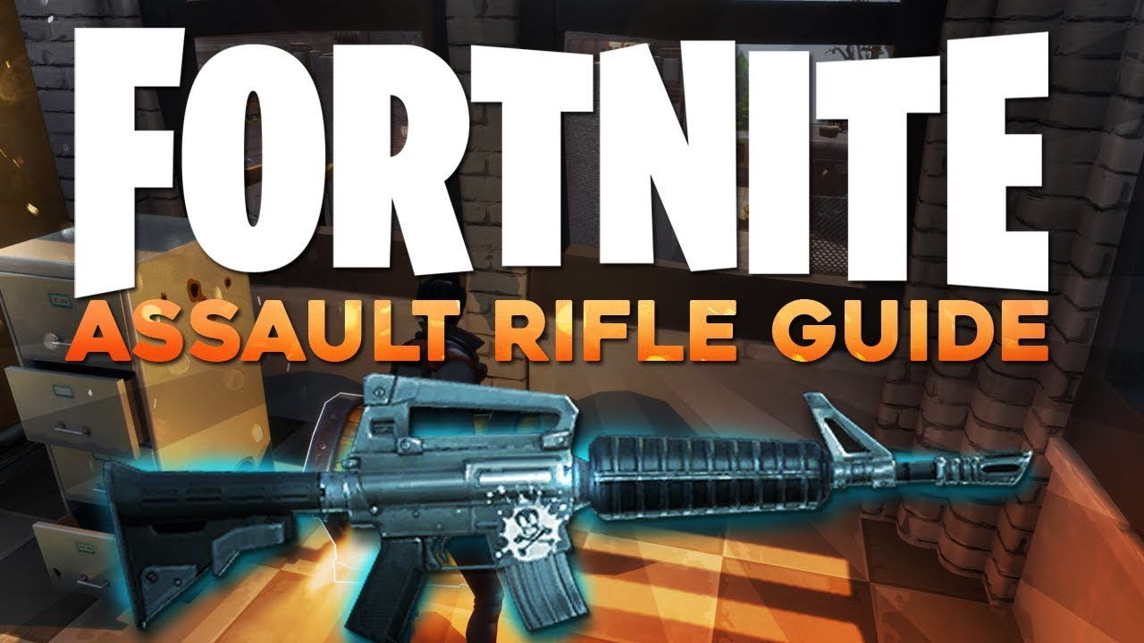
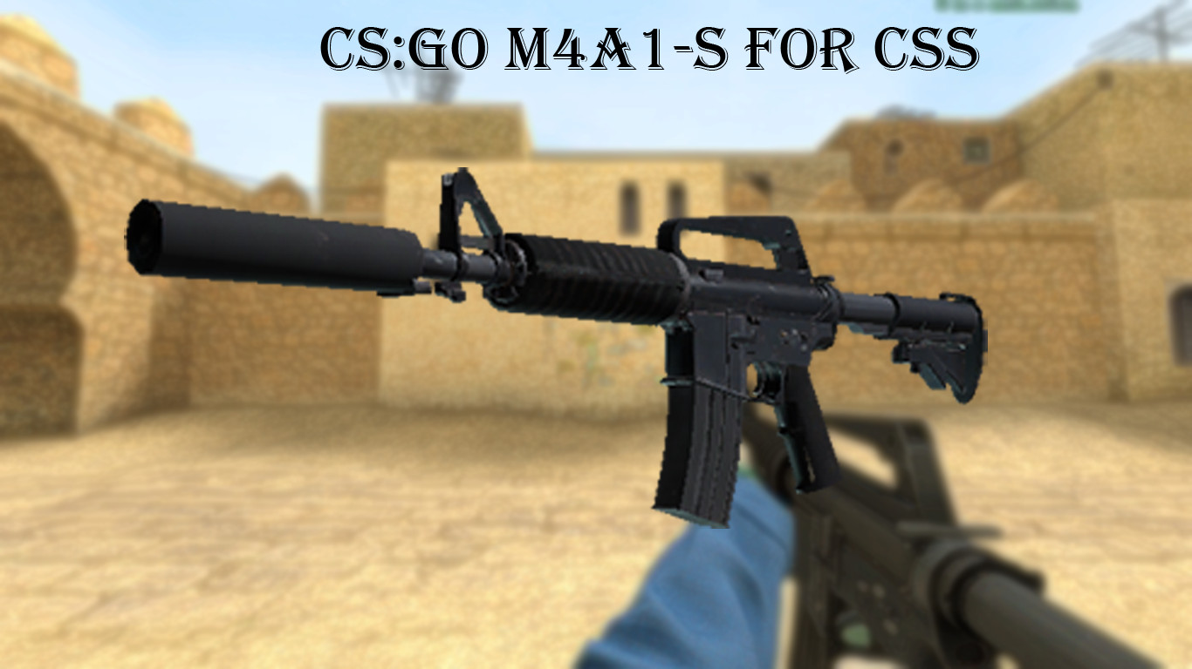
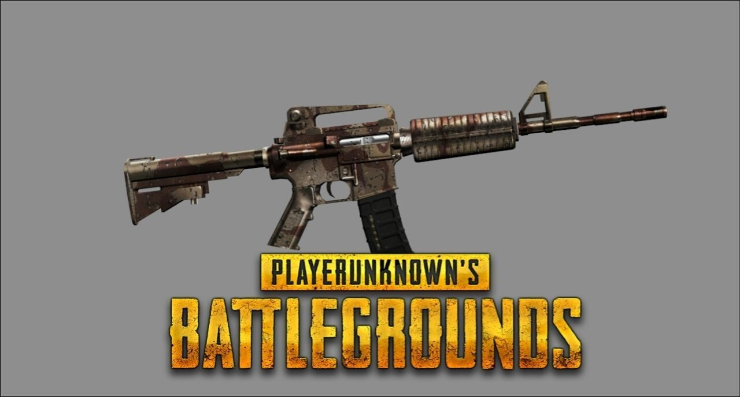
M4A1 In three different shooter games. Same weapon but different drawings.

Slide 16
Existing Games Don’t support:
1- Creation of unique non-fungible personalized assets.
2- Reuse of gaming assets like weapons, skins, etc. outside of the game.
Existing Blockchain games lack compelling gameplay.
Absence of the following features in VR games domain:
1- ‘Market hit’ Scheme
2- Affordable equipment
3- Complicated setup for trackers
4- in-platform compatibility for VR SDKs and Hardware
Problem Statement

Slide 17
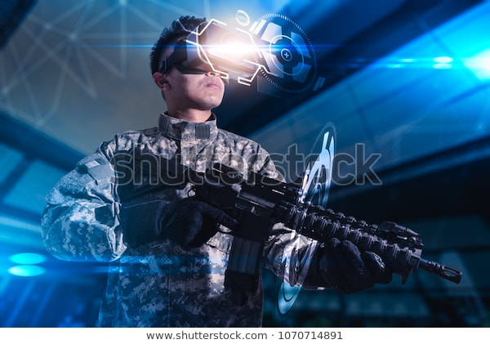
VR Set
Mobile Gaming
Hand Tracking
BlockChain Asset

Slide 18
Project Objectives
Development of a online multiplayer Shooter game which encompases:
Unique non-fungible assets owned by gamers using blockchain.
Ownership is proven by digital signatures and is protected by Distributed Ledger.
Items are tradeable and reusable in other games.
Game uses VR and Image Tracking capabilities.

Slide 19
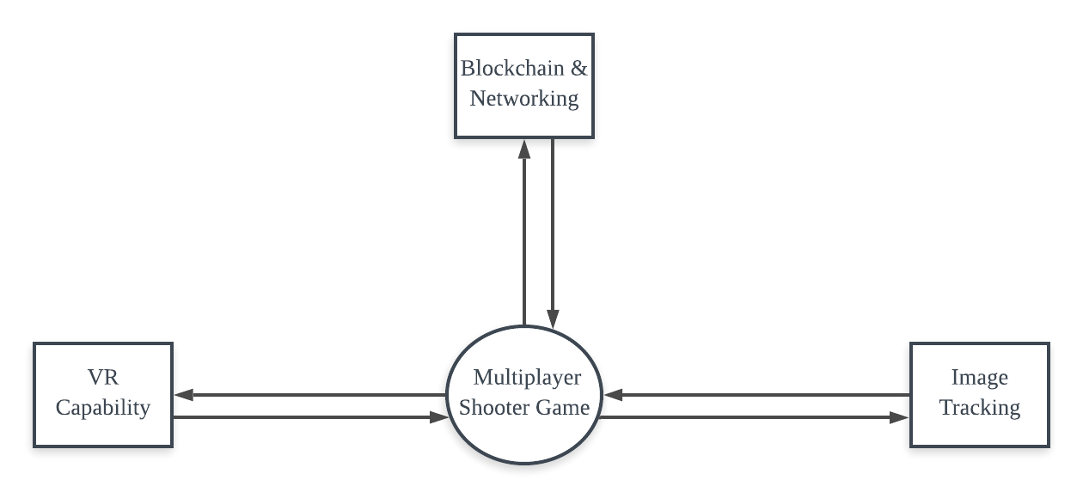
Context Diagram

Slide 20
Design & Implementation

Slide 21
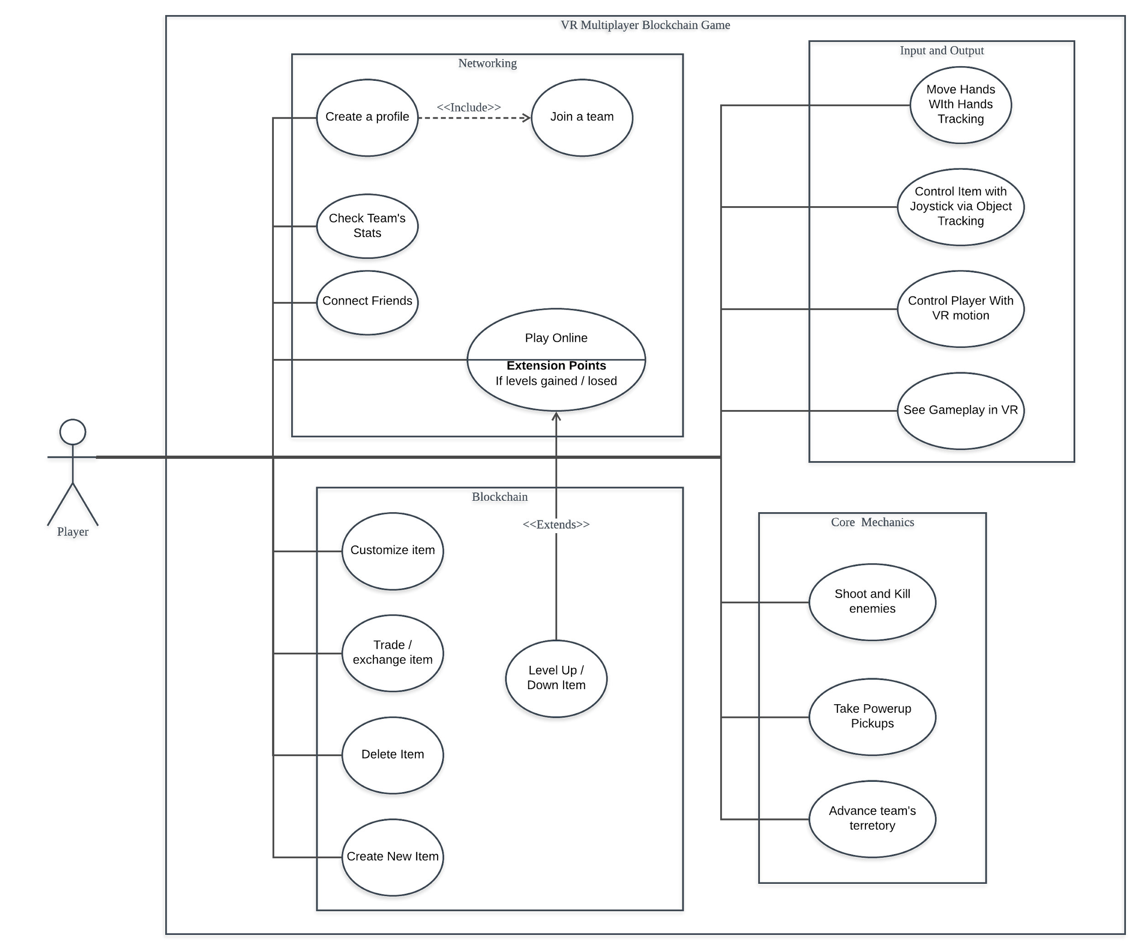
1- Use Case Diagram:
Design

Slide 22
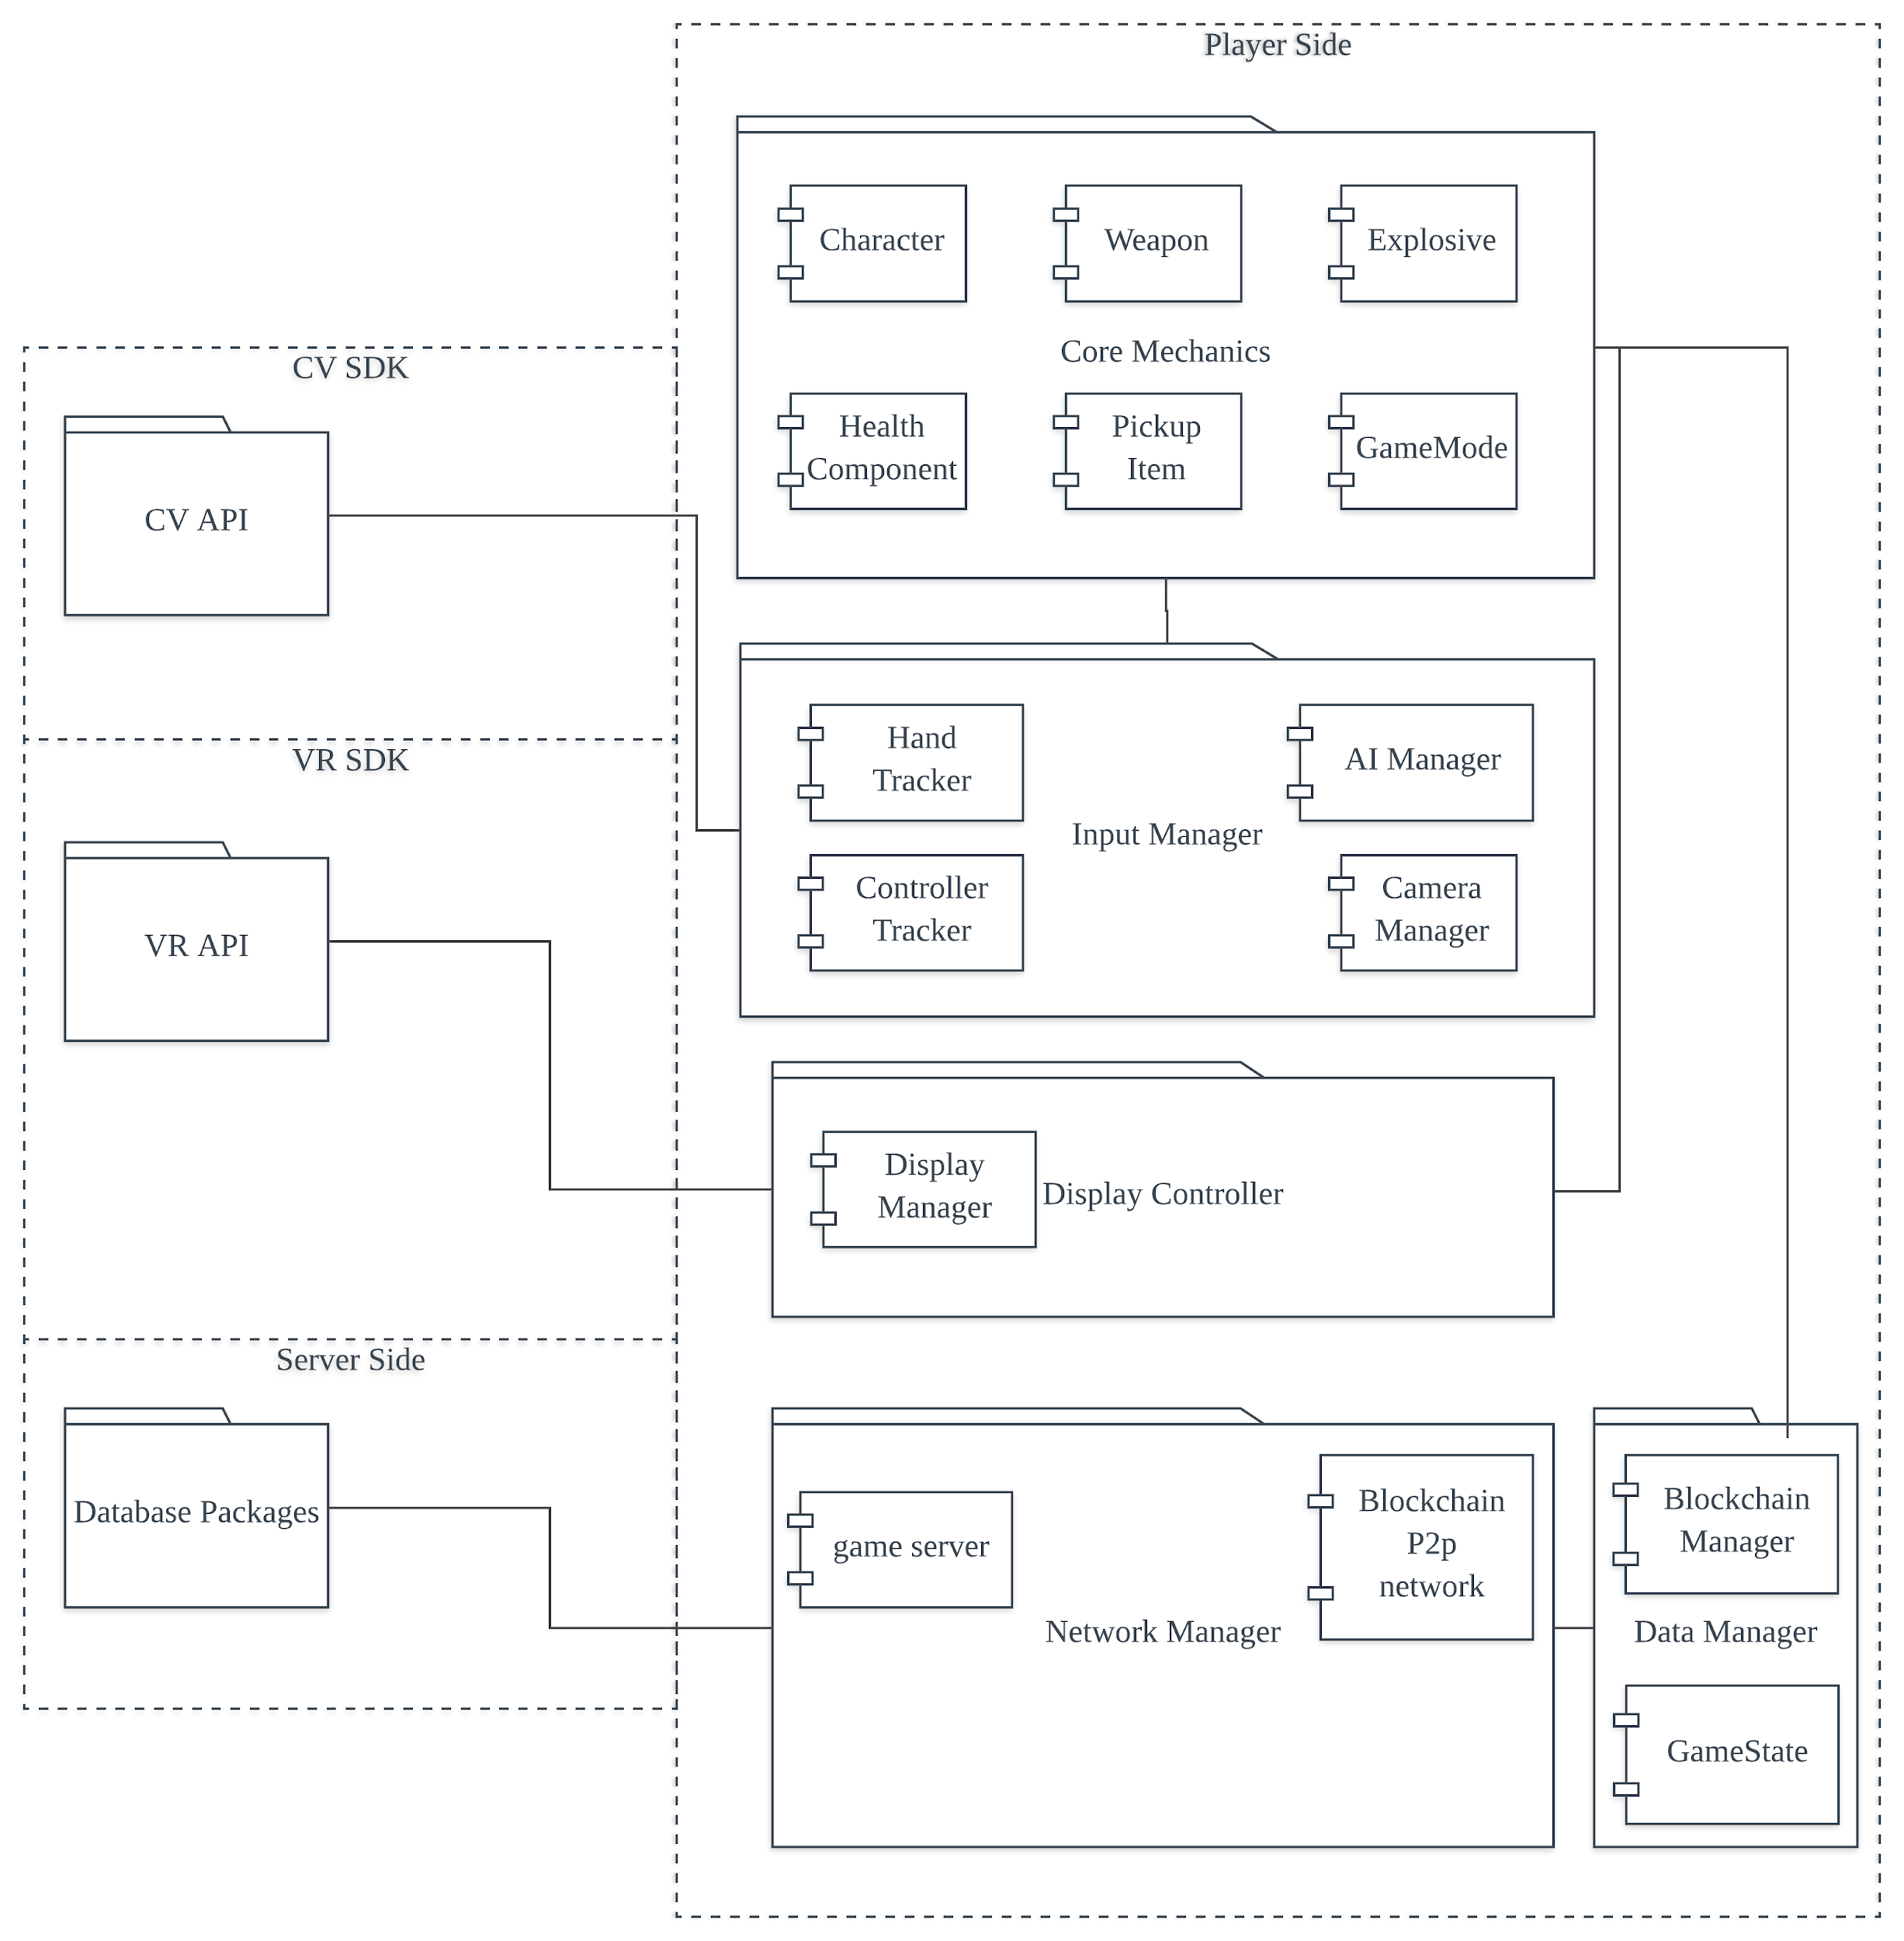
1- Package Diagram:
Design

Slide 23
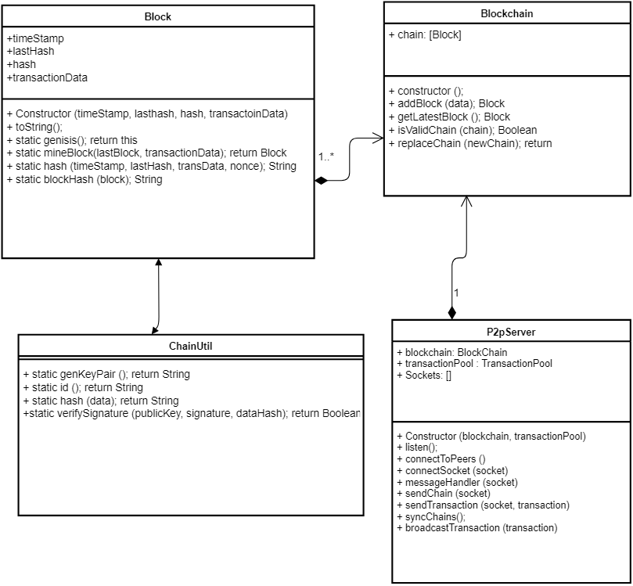
1- Class Diagrams:
Design

Slide 24
VR Blockchain Game Main working scheme
Assets are represented by Non-fungible tokens.
Identities own Assets and are represented by public keys.
Authority is proven by digital signature.
Transactions are signed by digital signature that connects it to an Identity.
Transactions Integrity is protected by public Ledger.

Slide 25
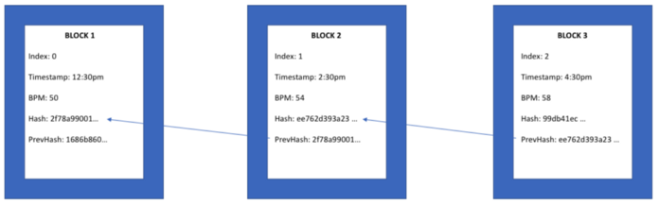

Slide 26
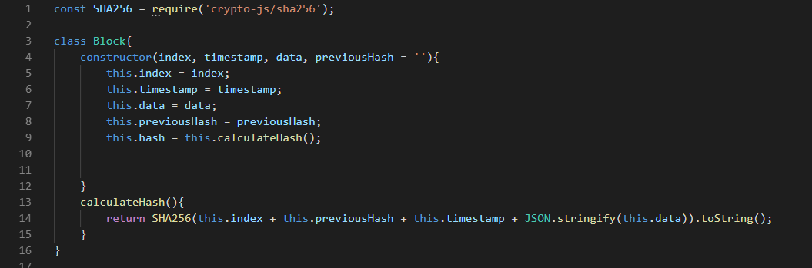
Block Class:
Code Snippets:

Slide 27
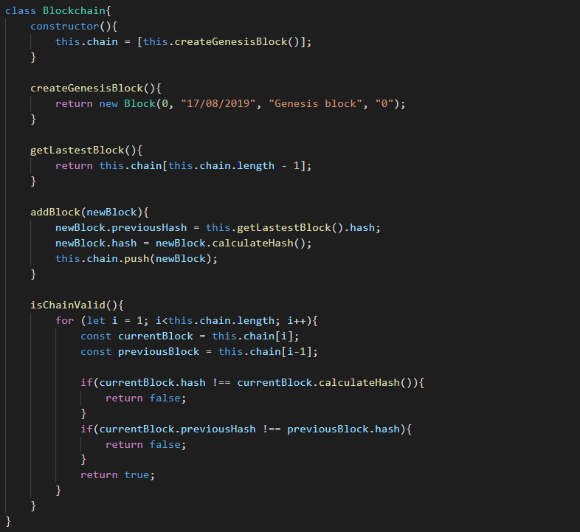
Blockchain module:
Code Snippets:

Slide 28
Blockchain module:
Code Snippets:

Slide 29
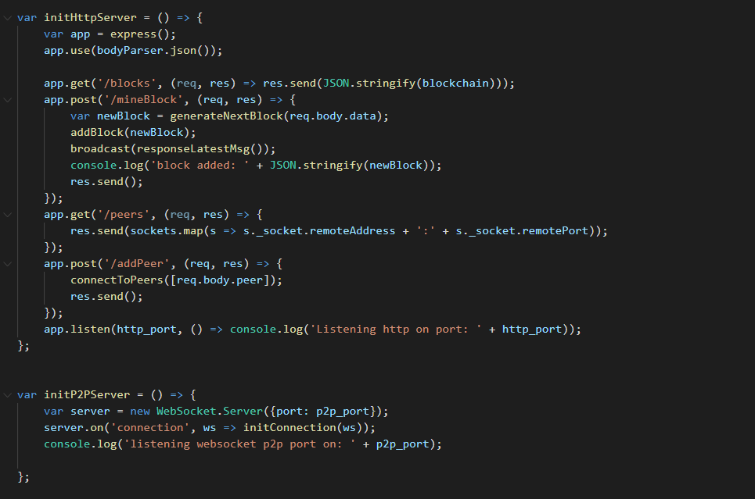
P2p networking module:
Code Snippets:

Slide 30
Background
Virtual Reality

Slide 31
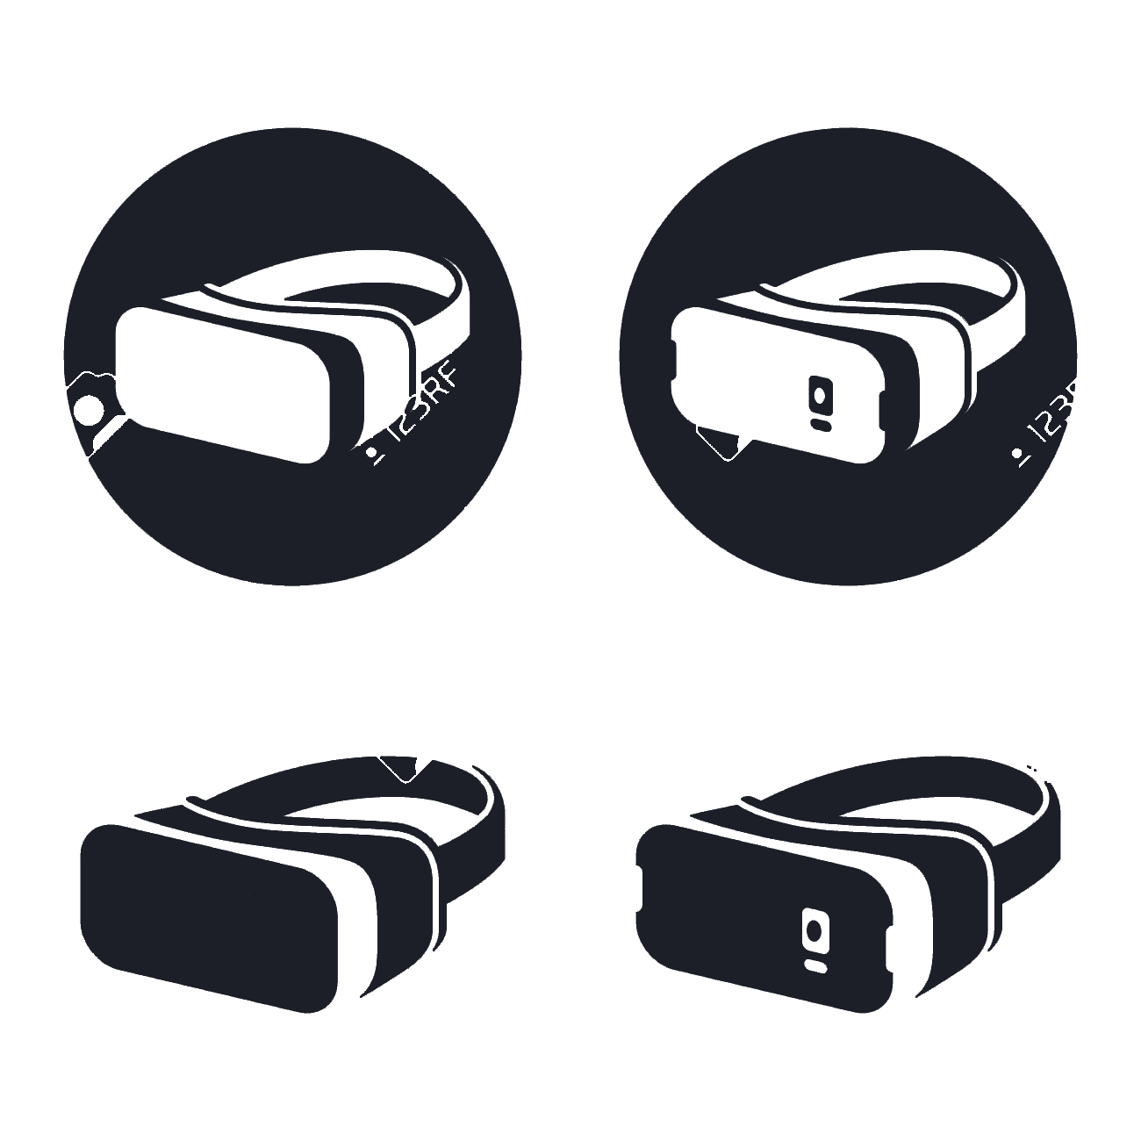
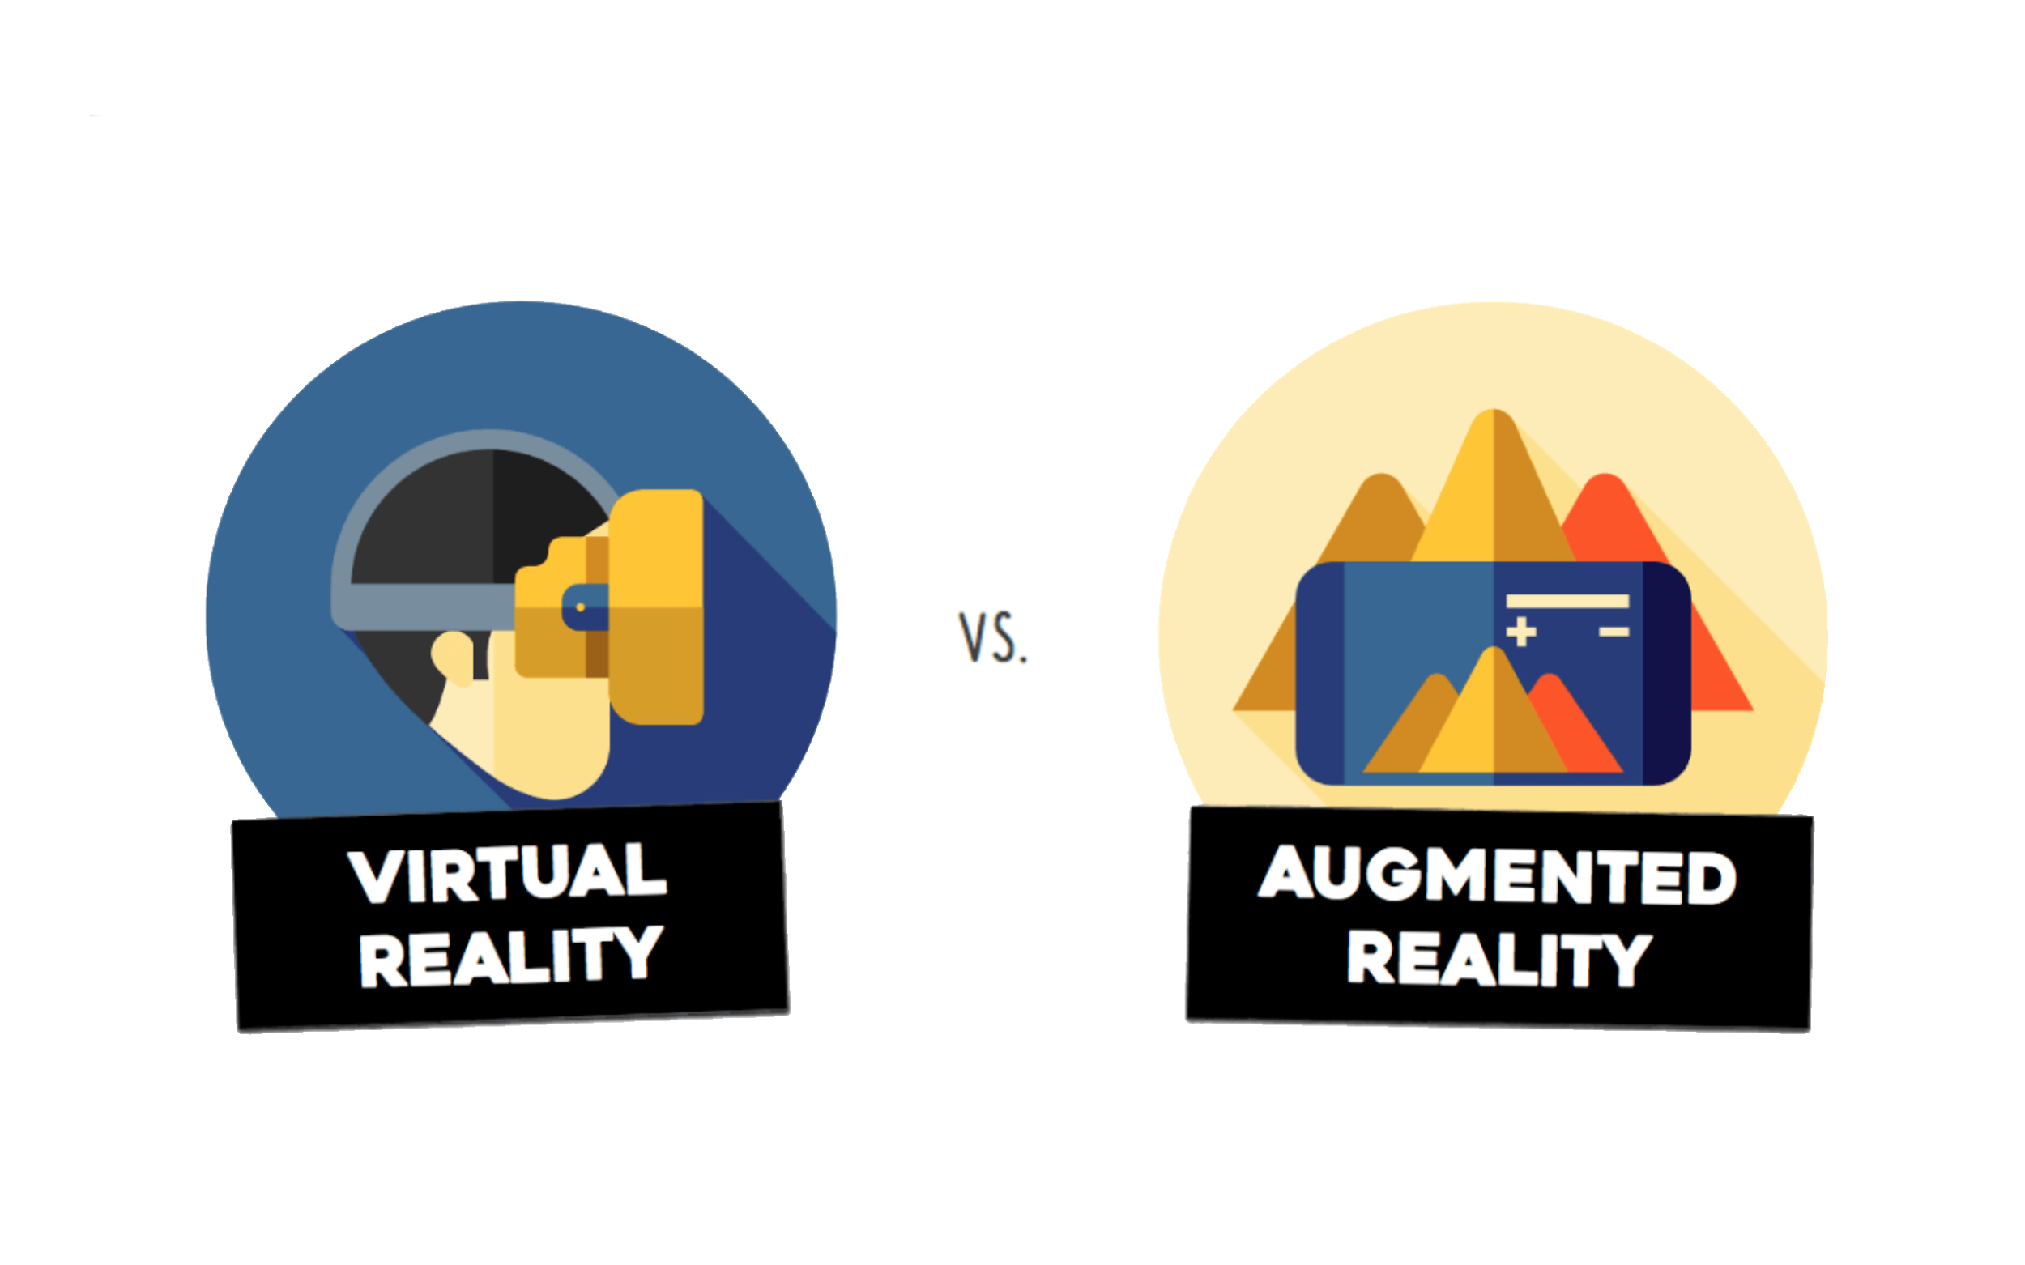



Background
VR / AR / MR
Stereo Vision
Headsets
Trackers
Rendering

Slide 32
Background
VR / AR / MR
Stereo Vision
Headsets
Trackers
Rendering

Slide 33
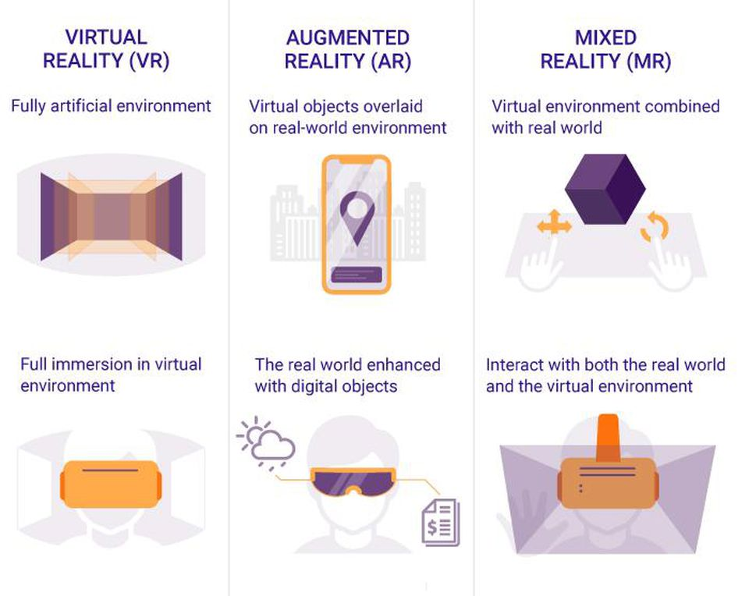

Slide 34
Background
VR / AR / MR
Stereo Vision
Headsets
Trackers
Rendering

Slide 35
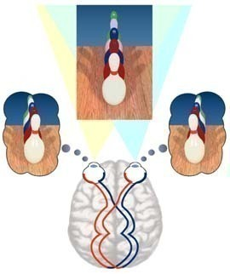

Slide 36
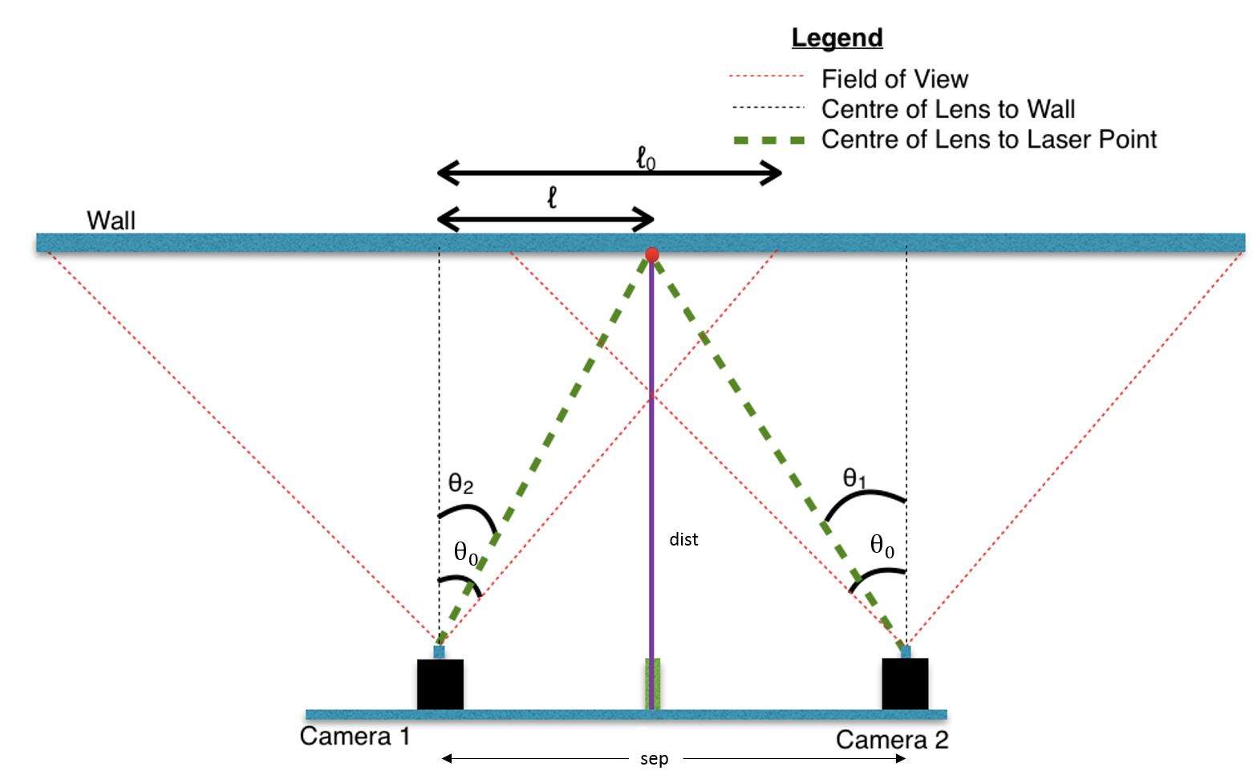

Slide 37
Background
VR / AR / MR
Stereo Vision
Headsets
Trackers
Rendering

Slide 38
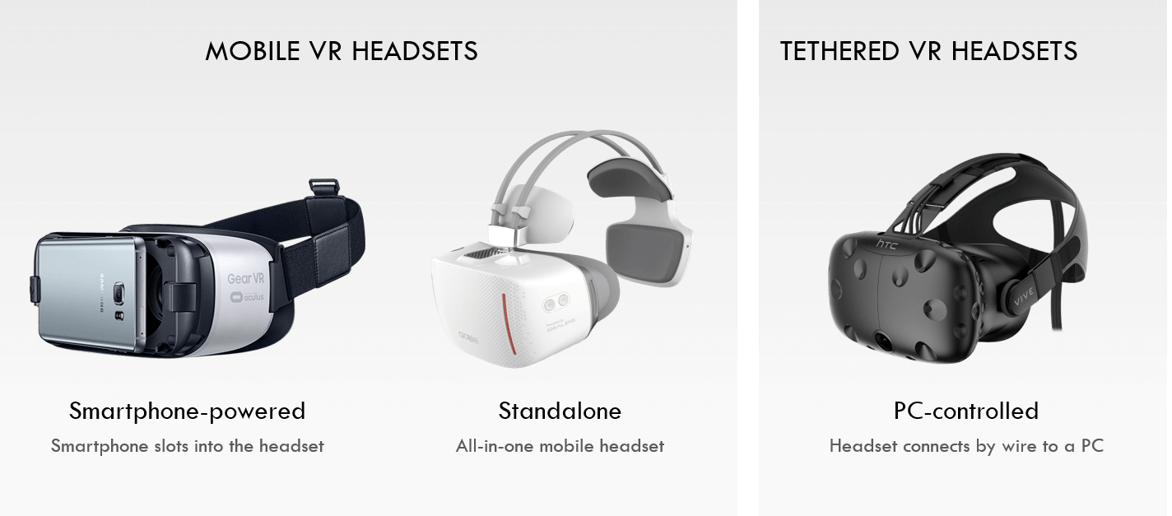
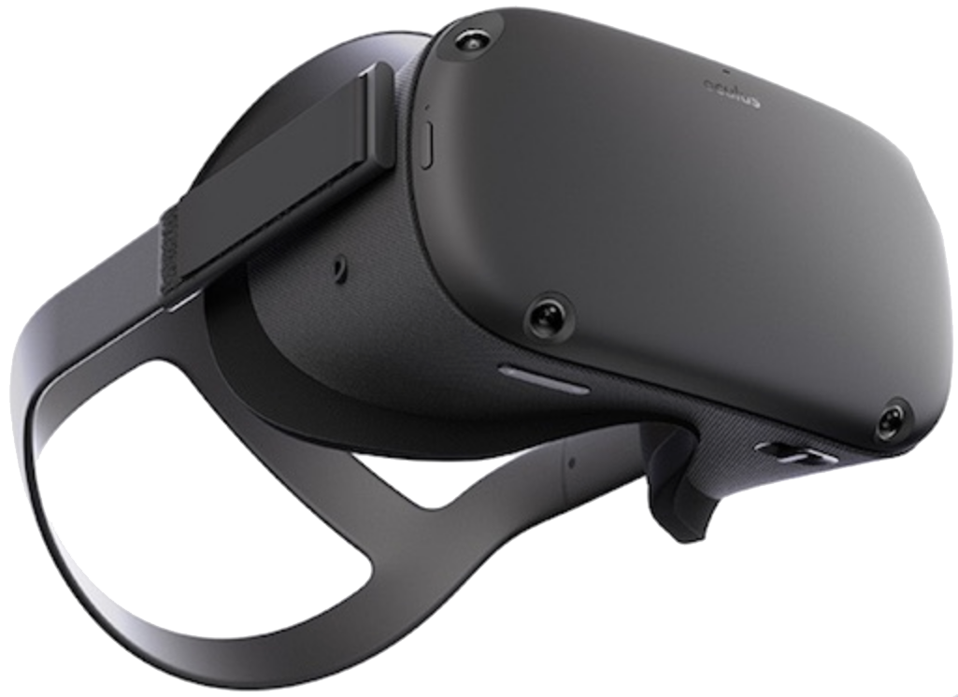
UNTETHERED VR HEADSETS
Wireless
Don't require a PC or a smartphone

Slide 39
Background
VR / AR / MR
Stereo Vision
Headsets
Trackers
Rendering

Slide 40
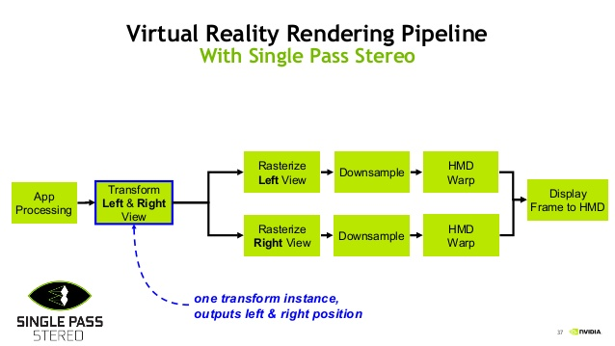
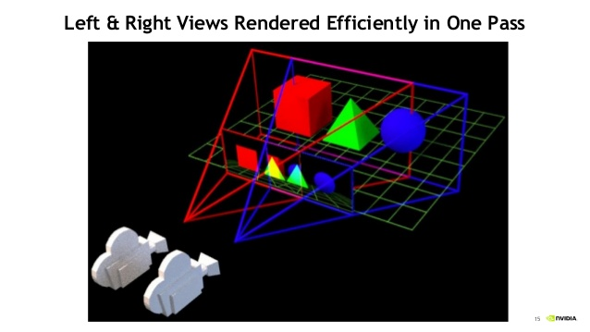

Slide 41
Background
VR / AR / MR
Stereo Vision
Headsets
Trackers
Rendering

Slide 42
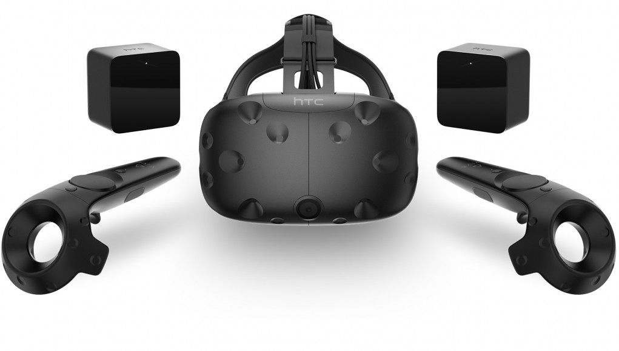

Slide 43
Problem statement

Slide 44
Existing Games Don’t support:
1- Creation of unique non-fungible personalized assets.
2- Reuse of gaming assets like weapons, skins, etc. outside of the game.
Existing Blockchain games lack compelling gameplay.
Absence of the following features in VR games domain:
1- ‘Market hit’ Scheme
2- Affordable equipment
3- Complicated setup for trackers
4- in-platform compatibility for VR SDKs and Hardware
Problem Statement

Slide 45
Existing Games Don’t support:
1- Creation of unique non-fungible personalized assets.
2- Reuse of gaming assets like weapons, skins, etc. outside of the game.
Existing Blockchain games lack compelling gameplay.
VR:
1- ‘Market hit’ Scheme
2- Affordable equipment
3- Complicated setup for trackers
4- in-platform compatibility for VR SDKs and Hardware
Problem Statement

Slide 46
Existing Games Don’t support:
1- Creation of unique non-fungible personalized assets.
2- Reuse of gaming assets like weapons, skins, etc. outside of the game.
Existing Blockchain games lack compelling gameplay.
VR:
1- ‘Market hit’ Scheme
2- Affordable equipment
3- Complicated setup for trackers
4- in-platform compatibility for VR SDKs and Hardware
Problem Statement

Slide 47
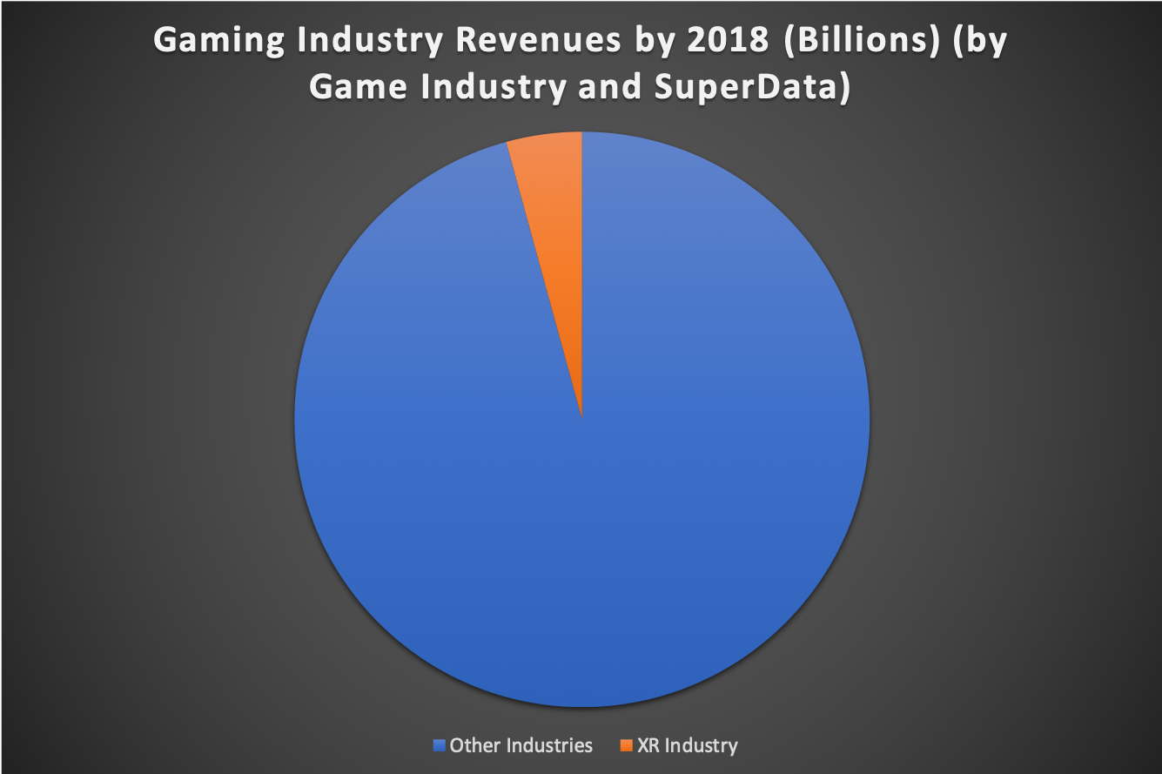

Slide 48
Existing Games Don’t support:
1- Creation of unique non-fungible personalized assets.
2- Reuse of gaming assets like weapons, skins, etc. outside of the game.
Existing Blockchain games lack compelling gameplay.
VR:
1- ‘Market hit’ Scheme
2- Affordable equipment
3- Complicated setup for trackers
4- in-platform compatibility for VR SDKs and Hardware
Problem Statement

Slide 49
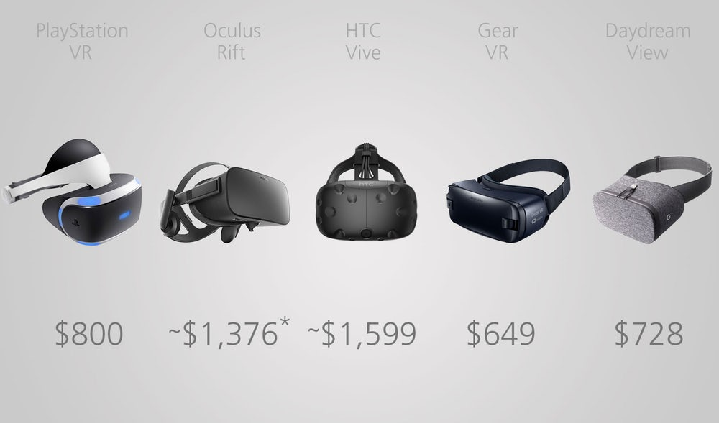

Slide 50
Existing Games Don’t support:
1- Creation of unique non-fungible personalized assets.
2- Reuse of gaming assets like weapons, skins, etc. outside of the game.
Existing Blockchain games lack compelling gameplay.
VR:
1- ‘Market hit’ Scheme
2- Affordable equipment
3- Complicated setup for trackers
4- in-platform compatibility for VR SDKs and Hardware
Problem Statement

Slide 51
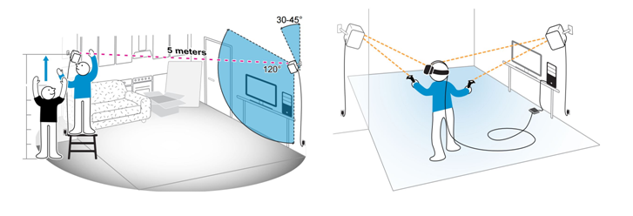

Slide 52
Existing Games Don’t support:
1- Creation of unique non-fungible personalized assets.
2- Reuse of gaming assets like weapons, skins, etc. outside of the game.
Existing Blockchain games lack compelling gameplay.
VR:
1- ‘Market hit’ Scheme
2- Affordable equipment
3- Complicated setup for trackers
4- in-platform compatibility for VR SDKs and Hardware
Problem Statement

Slide 53
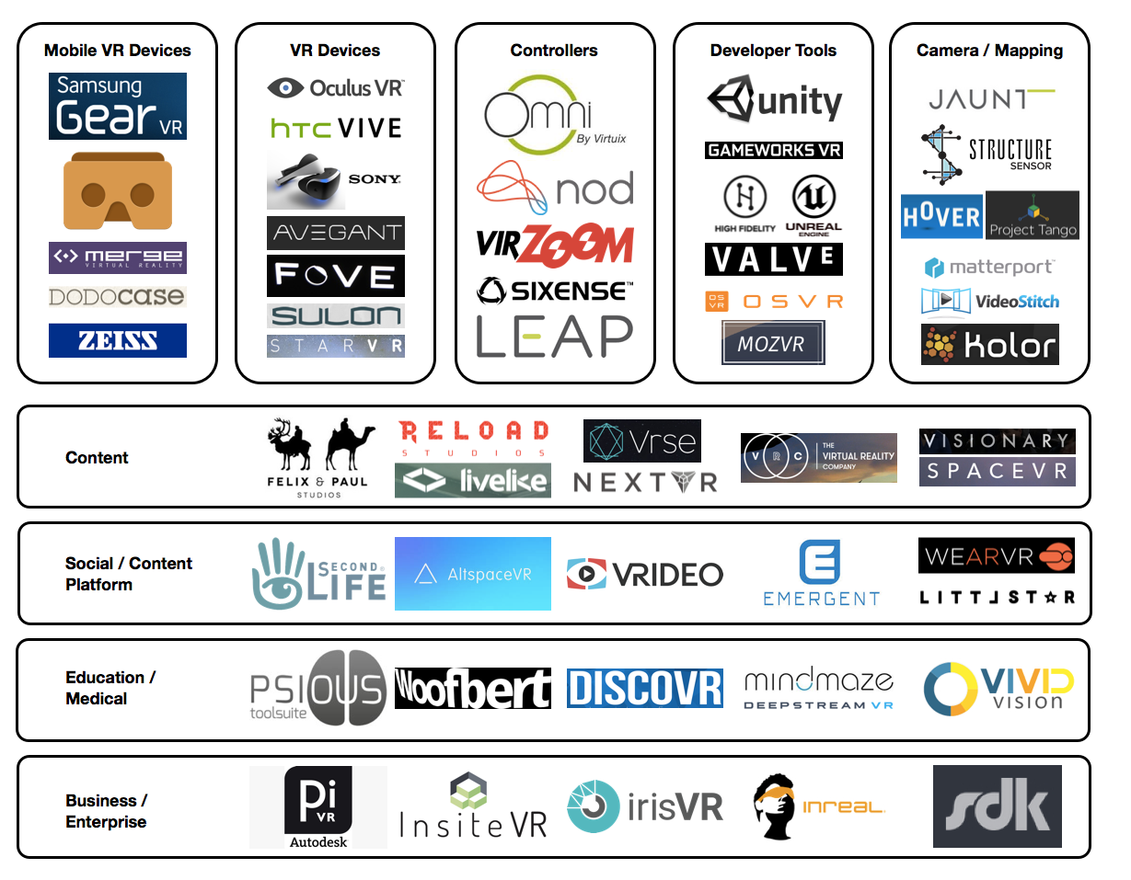

Slide 54
Literature review
VR Games

Slide 55
Game Engines
VR SDK
Motion Tracking
Games
Literature Review

Slide 56

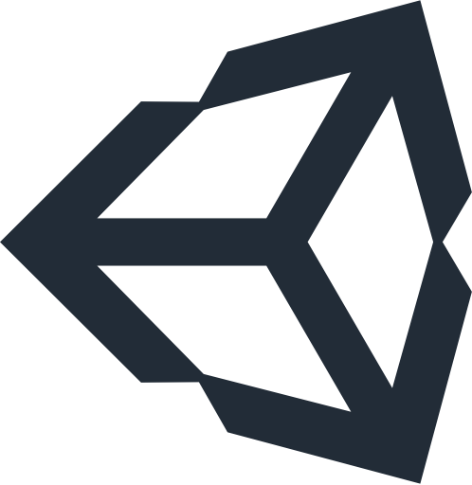

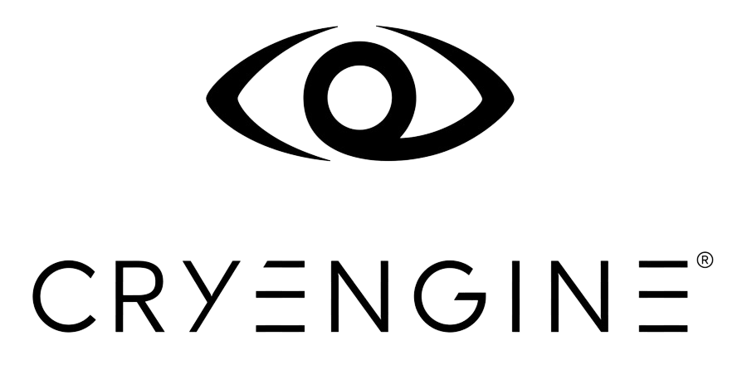
1- Game Engines
Literature Review

Slide 57
1- Game Engines
Literature Review
Optimization
Friendly Environment
Optimization
Friendly Environment
Mult-Framework Environment
Light Renderer
Mult-Framework Environment
Mult-Framework Environment
Active Community
Mildly Supported
Active Community
Deserted Community
Highly Supported
Not Supported
Highly Supported
Complicated
No Low-level access
Forces blueprint system
C# Only

Slide 58
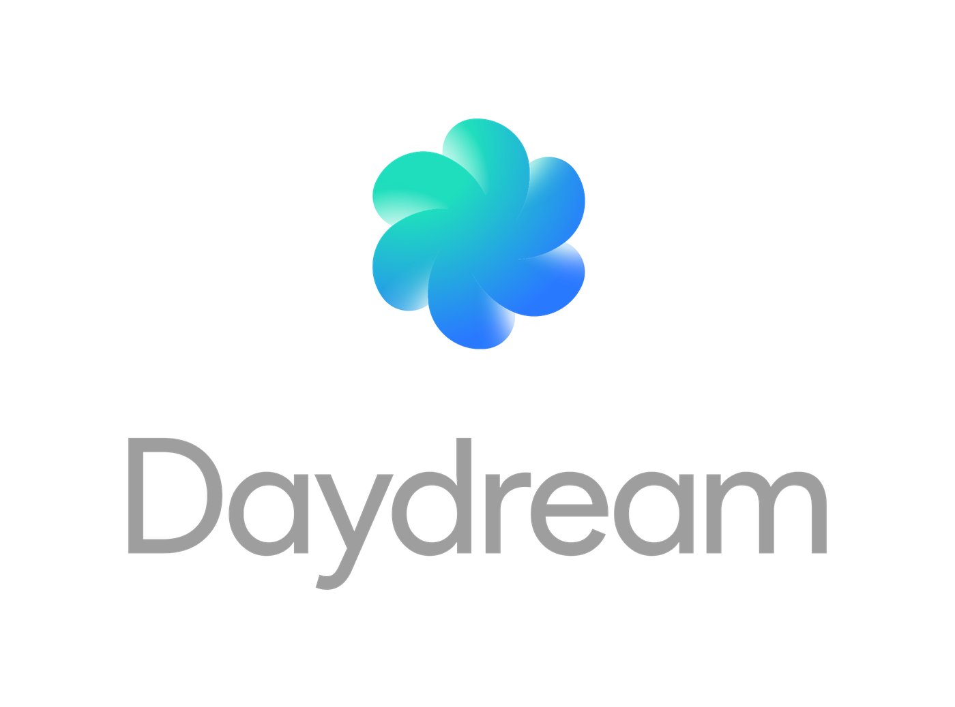
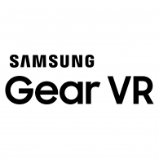

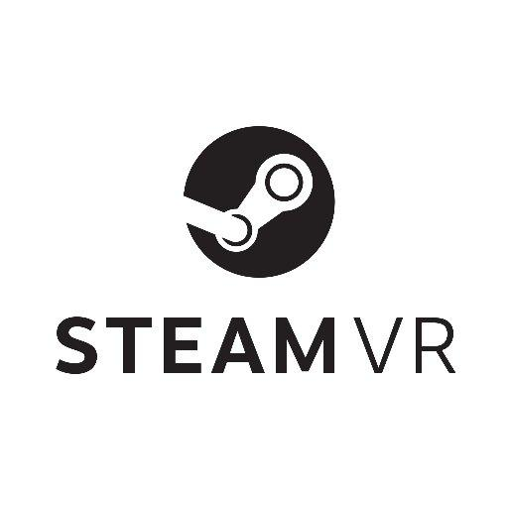
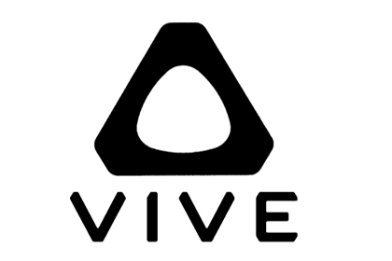
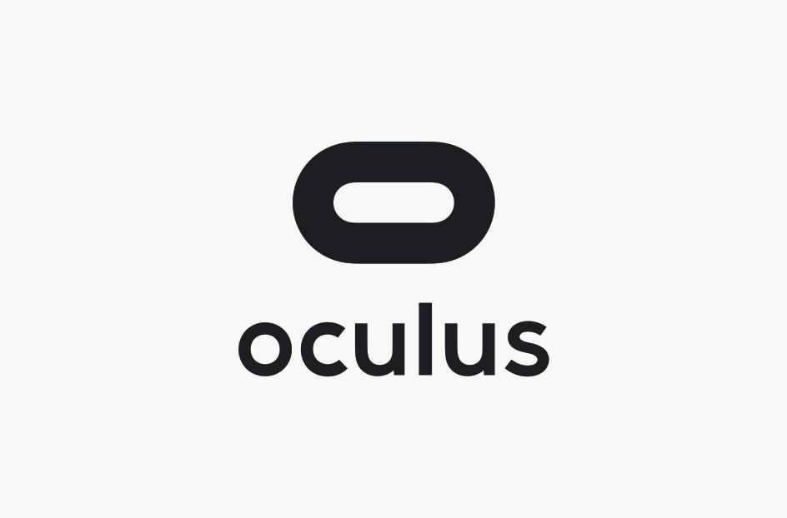
2- VR SDKs
Literature Review

Slide 59
2- VR SDKs
Literature Review

Slide 60
2- VR SDKs
Literature Review

Slide 61



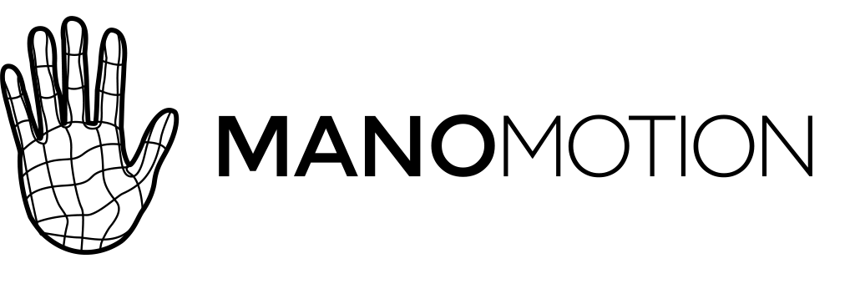
3- Motion Tracking
Literature Review

Slide 62
4- Games
Literature Review
VR Specific
Need specific equipements
Lack gameplay
Just an importation

Slide 63
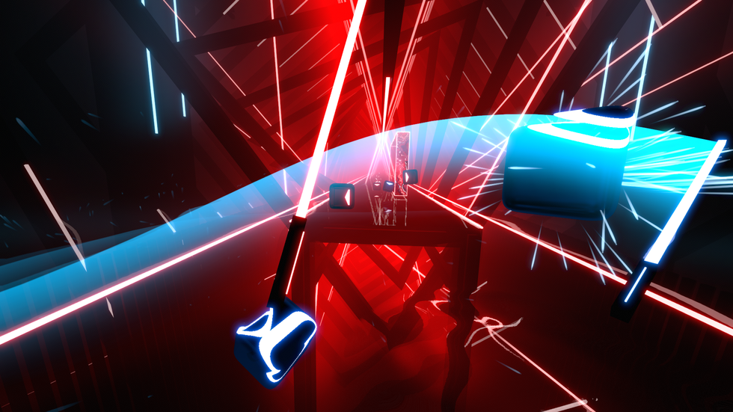

Slide 64
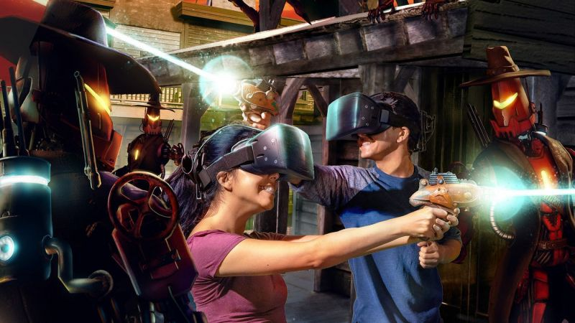

Slide 65
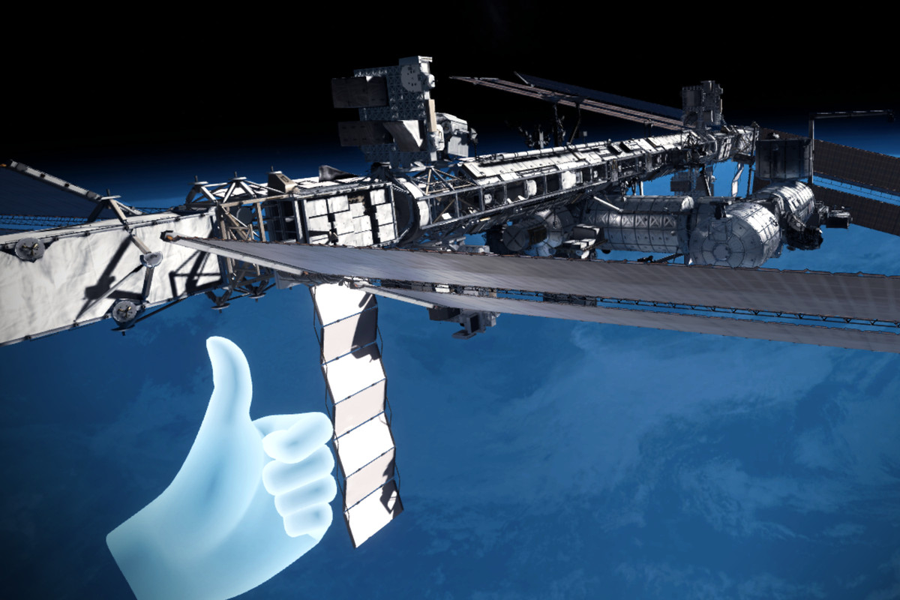

Slide 66
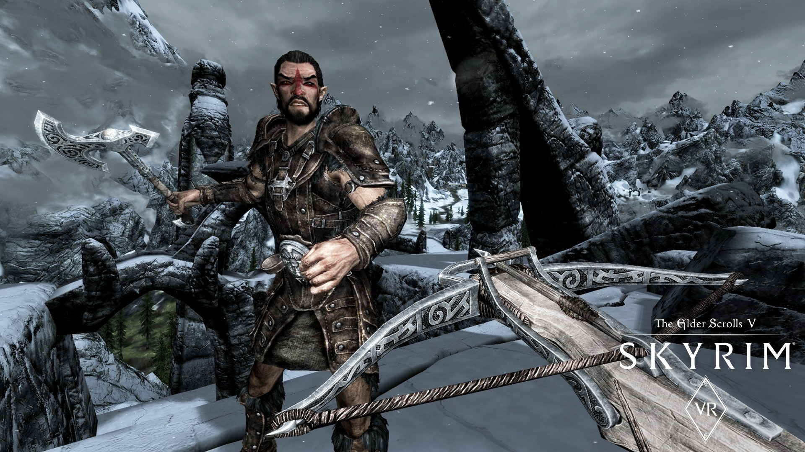

Slide 67
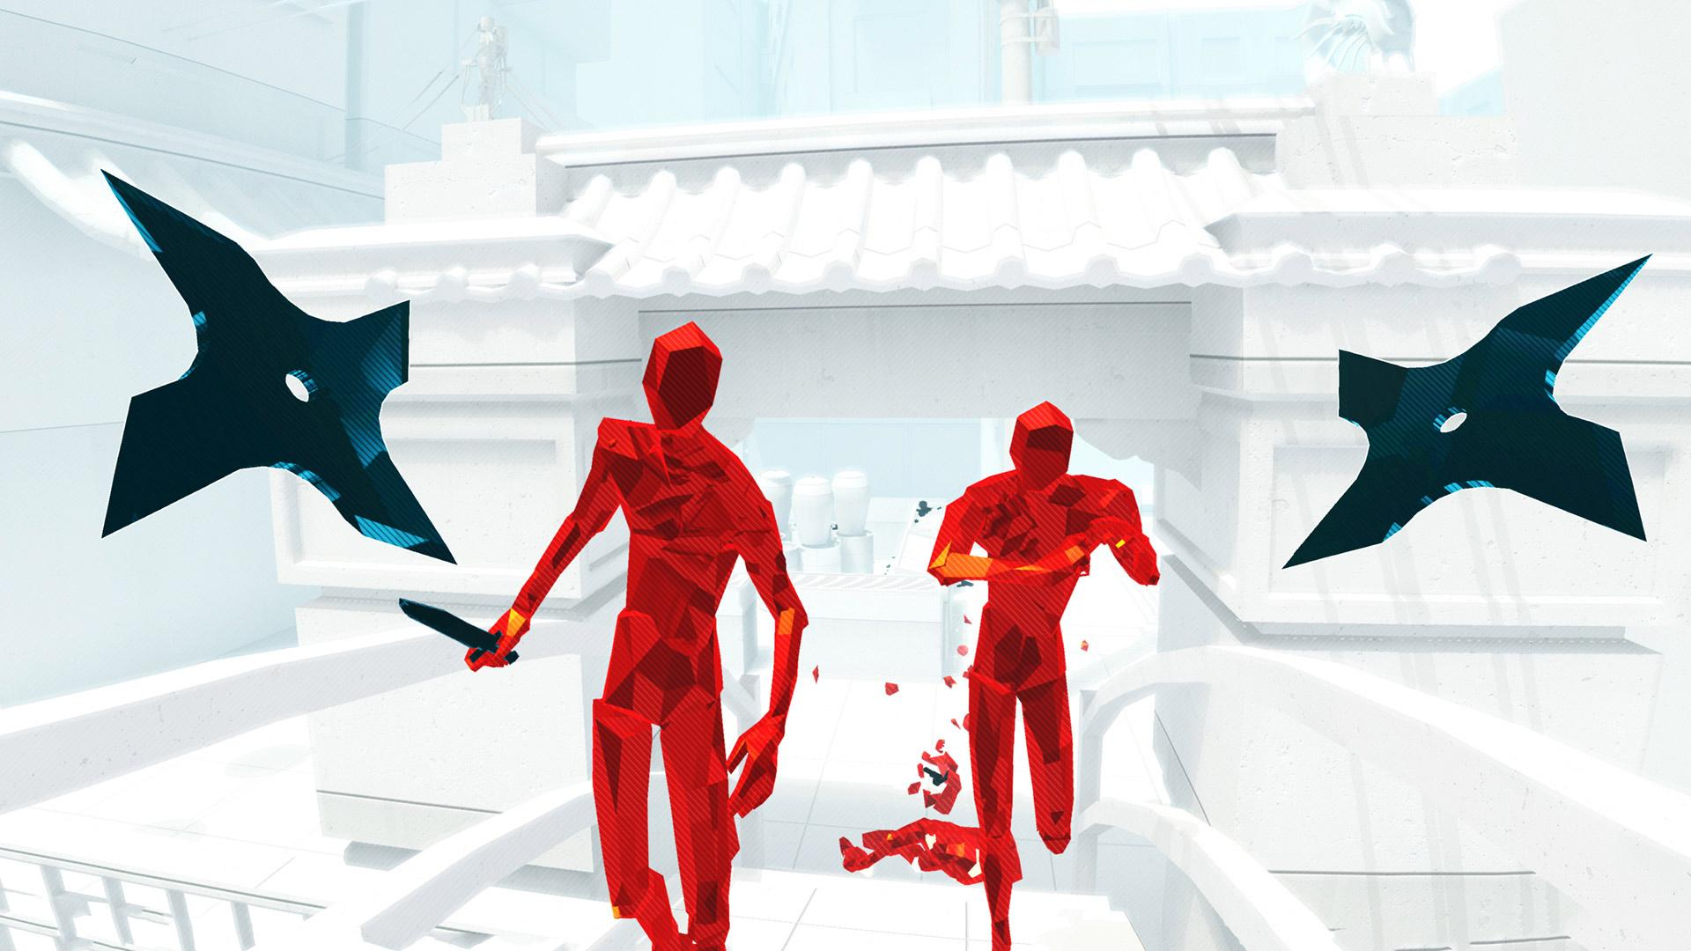
There are some good Games...

Slide 68
Design

Slide 69
1- Use Case Diagram:
Design

Slide 70
2- Context Diagram:
Design

Slide 71
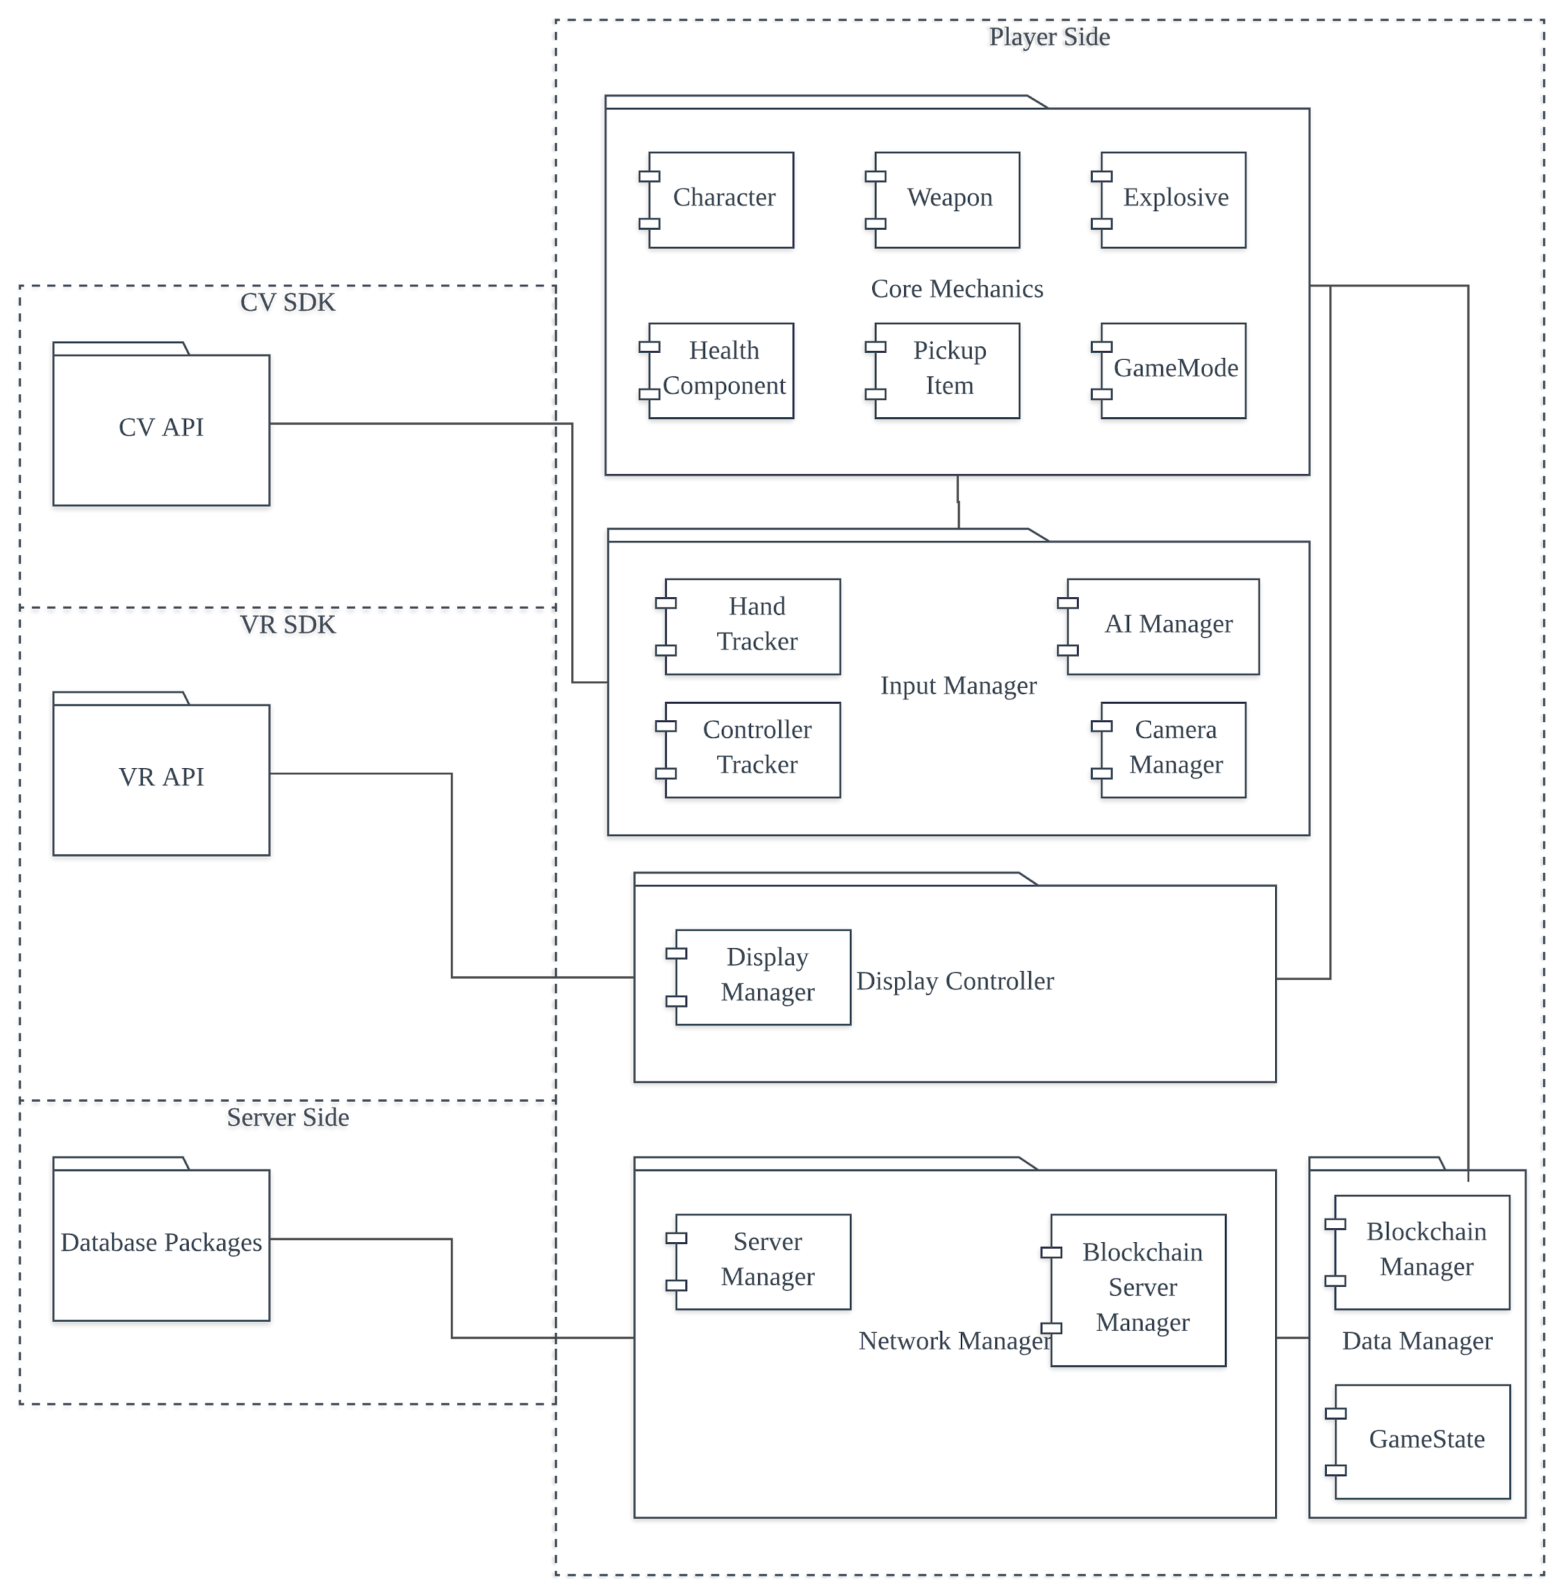
3- Package Diagram:
Design

Slide 72
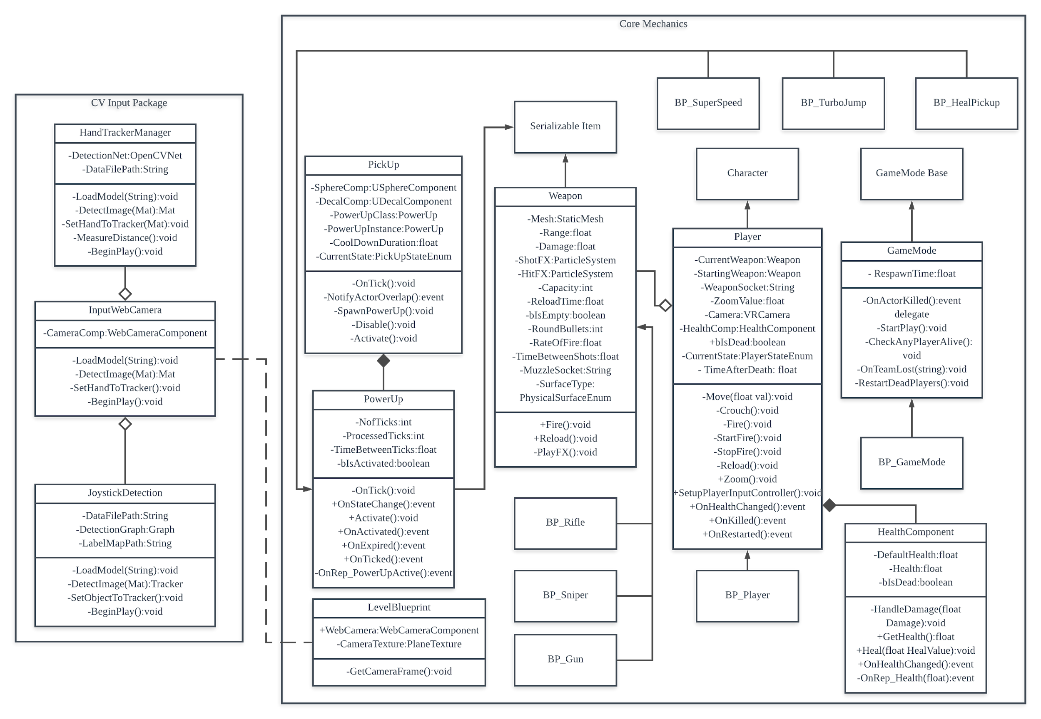
4- Class
Diagram:
Design

Slide 73

5- Activity
Diagram:
Design

Slide 74

5- Activity
Diagram:
Design

Slide 75
5- Activity
Diagram:
Design

Slide 76

5- State
Diagram:
Design

Slide 77
5- State
Diagram:
Design

Slide 78
Contributions
Bisher

Slide 79
Joint Development Core Game Mechanics (Unreal Engine)
Multiplayer Networking(Unreal Engine).
VR SDK and Motion Tracking(Google Cardboard).
Hand Tracking (OpenCV).
Joystick Tracking(TensorFlow)
Languages used: C++ , Python, C#, Unreal Blueprint System.
Bisher:

Slide 80
Industry Collaboration
1- Zakti Strategic Design SDN. BHD.
2- Unreal Developers Meetup
3- GameDev Hangout

Slide 81


Slide 82


Slide 83



Slide 84

About the company...

Slide 85
Demo

Slide 86
Conclusion

Slide 87
Q & A
Thanks very much for listening

